Slide 1




Stroke Predictions
Andrea Cohen

Slide 2
Context
According to the World Health Organization (WHO) stroke is the 2nd leading cause of death globally, responsible for approximately 11% of total deaths.
This dataset is used to predict whether a patient is likely to have a stroke based on the input parameters like gender, age, various diseases, and smoking status. Each row in the data provides relevent information about the patient.

Slide 3
Stakeholders
Patients–
the data include behavioral information (relationship status, work type, residence type, and smoking status) that help predict strokes.
Medical Professionals–
the data include medical information (hypertension, heart disease, average glucose level, and BMI) that help predict strokes.
Institutions (Hospitals, Insurance Companies, Pharmaceutical Companies, and Public Health Officials)–
the data include behavioral information, medical information, and patient characteristics (gender and age) that help predict strokes, manage resources, and direct marketing.

Slide 4
Task
To predict whether you are likely to have a stroke based on some of your characteristics
To help you understand how your behavioral and medical characteristics increase your risk of stroke
To help you make informed decisions about your behavior and healthcare

Slide 5
Data
Source: From Kaggle
10 clinical features for predicting stroke events: Relationship Status, Work Type, Residence Type, Smoking Status, Hypertension, Heart Disease, Average Glucose Level, BMI, Gender, Age
1 binary target: No Stroke class and Stroke class
5110 patients

Slide 6
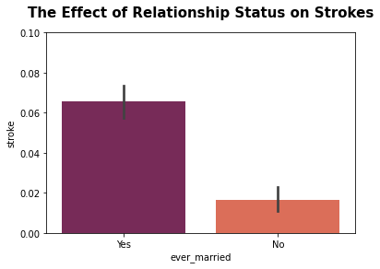
Does relationship status increase strokes?
Married and previously married people are about 4x more likely to have a stroke.

Slide 7
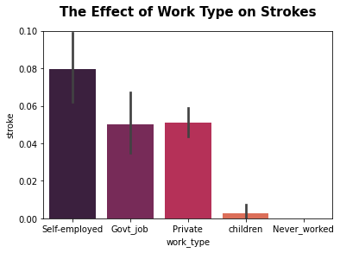
Does work type increase strokes?
Self-employed, government-employed, and privately-employed people are about 62x more likely to have a stroke.

Slide 8
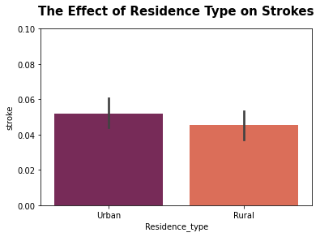
Does residence type increase strokes?
Urban residents are not more likely to have strokes.

Slide 9
Predictive Model: Tuned LightGBM with SMOTE and Feature Engineering
Gradient boosting (sequentially fitting models on the errors of the previous models) for increasing model performance
Synthetic Minority Oversampling Technique (creating new synthetic data that is very similar to the data in the minority class) for dealing with imbalanced classes
Feature engineering (deleting data and combining data) for better machine learning results

Slide 10
Model Evaluation
Because of the class imbalance, the final model must predict well for the stroke class
Because of the high cost of false negatives (predicting no stroke when, in fact, there will be a stroke), these errors must be reduced

Slide 11
Model Strengths
The final model achieved 93% accuracy for making correct predictions for new patients.
The final model successfully classified 98% of the no stroke samples

Slide 12
Model Weaknesses
The final model successfully classified only 11% of the stroke class.
Plus, it had an 89% rate of false negatives--that means that 89% of people who will have a stroke were actually predicted to not have a stroke!

Slide 13
Even more model weaknesses
For the best model, the data were significantly manipulated first
Synthetic oversampling
Feature engineering
The behavior characteristics that are most interesting for the patient stakeholder were the most affected
Residence data were deleted
Relationship and work data were combined
In the end, behavior characteristics did not impact stroke predictions at all!

Slide 14
Final Recommendations
This model is not ready for real-world data with real-world consequences.
New data should be collected, with more balanced classes, fewer missing values, and more specific information (numeric information should not be binned into categories).
In the meantime, patients should make their life decisions (about marriage, work, and residence) based on factors other than the risk of a stroke.

